Slide 1
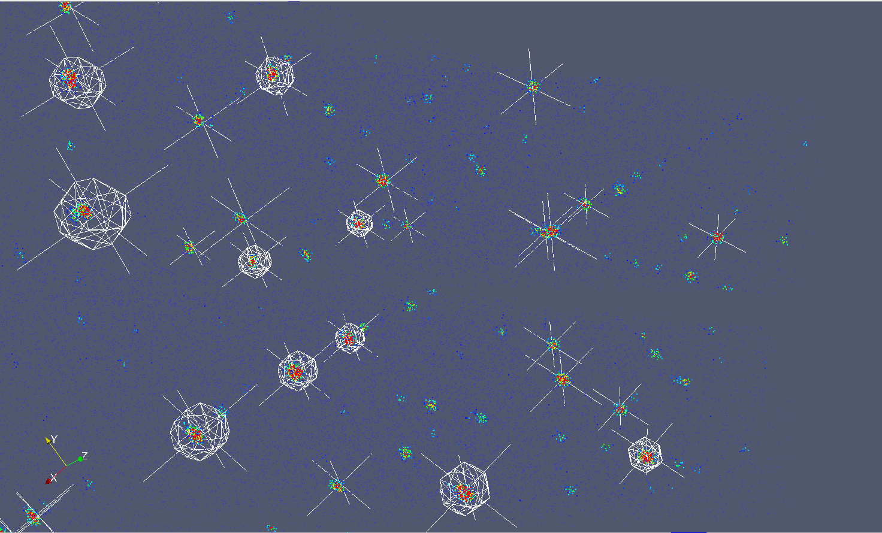
Mantid 2.4
Scientific Steering Committee
Scattering of Triphylite on TOPAZ in reciprocal space.

Slide 2
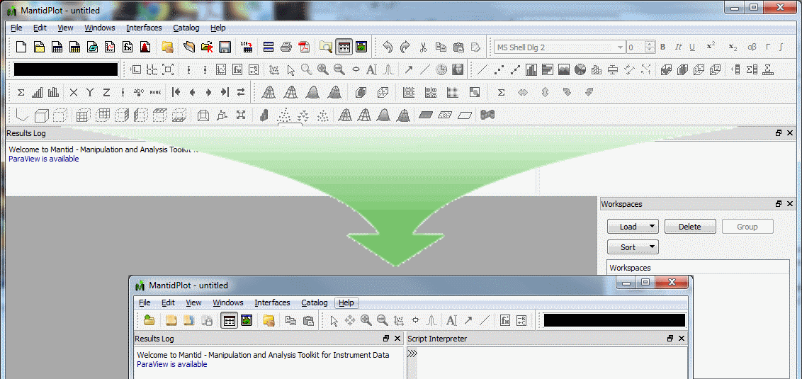
Simplified User Interface

Slide 3
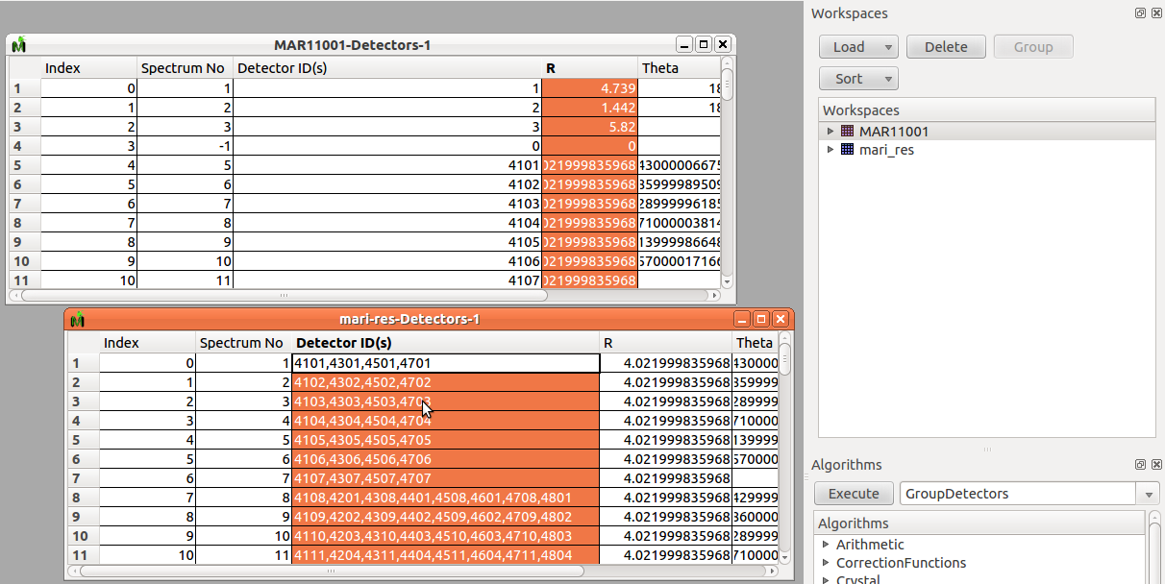
User Interface Grouped Detectors

Slide 4
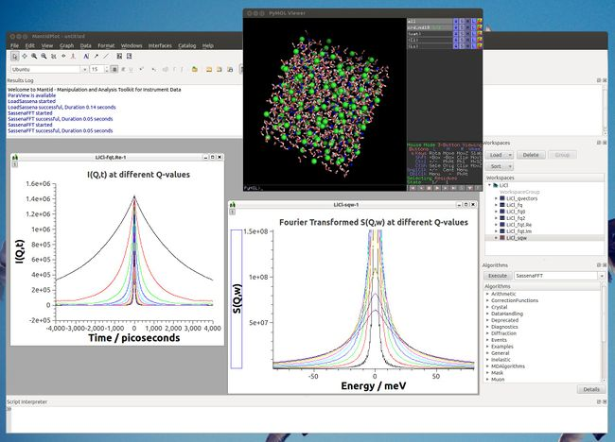
Loading MD Simulation Data

Slide 5
Python
# Set whole numpy array to workspace spectrum
nspectra = 2
xlength = 11
ylength = 10
test_ws = WorkspaceFactory.create("Workspace2D”,nvectors,xlength,ylength)
ws_index = 1
y_values = np.linspace(0,1,xlength)
test_ws.setX(ws_index, y_values)
x_values = np.ones(ylength)
test_ws.setY(ws_index, x_values)
e_values = np.sqrt(values)
test_ws.setE(ws_index, e_values)
# Access goniometer angles
wksp.getRun().getGoniometer().getEulerAngles("yzy")

Slide 6
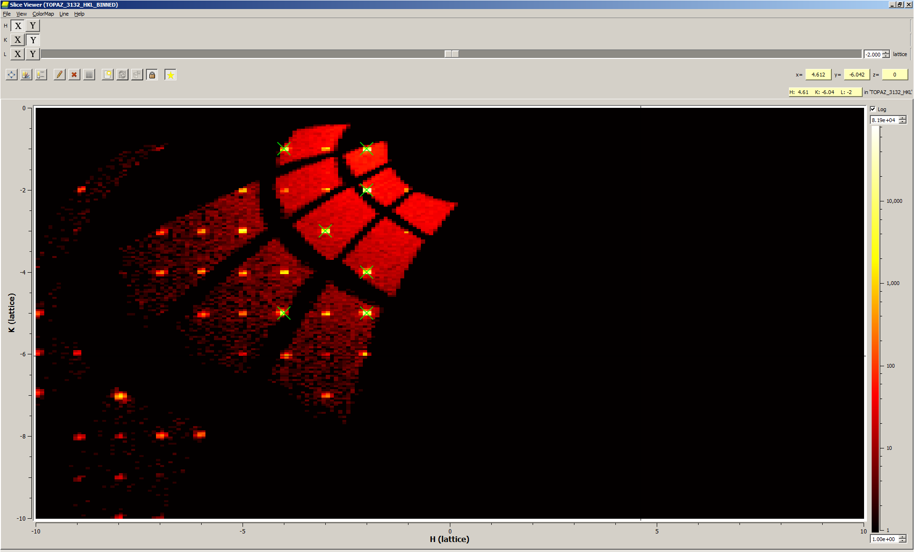
PeaksViewer (Addon to SliceViewer)

Slide 7
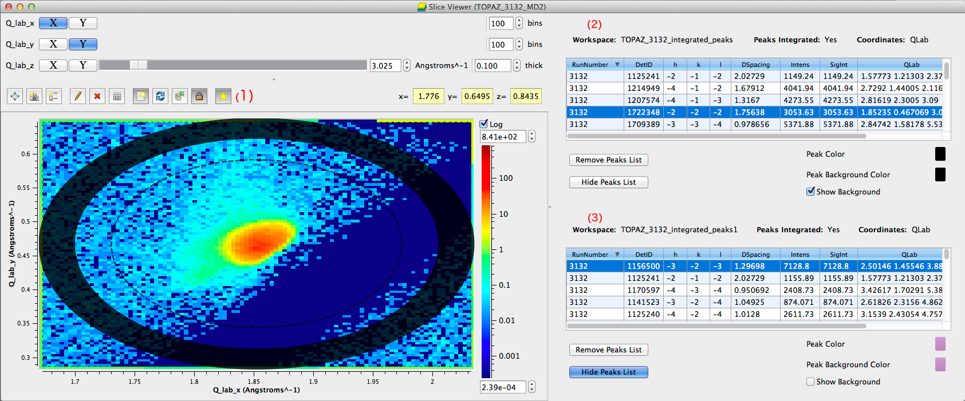
PeaksViewer (Addon to SliceViewer)

Slide 8
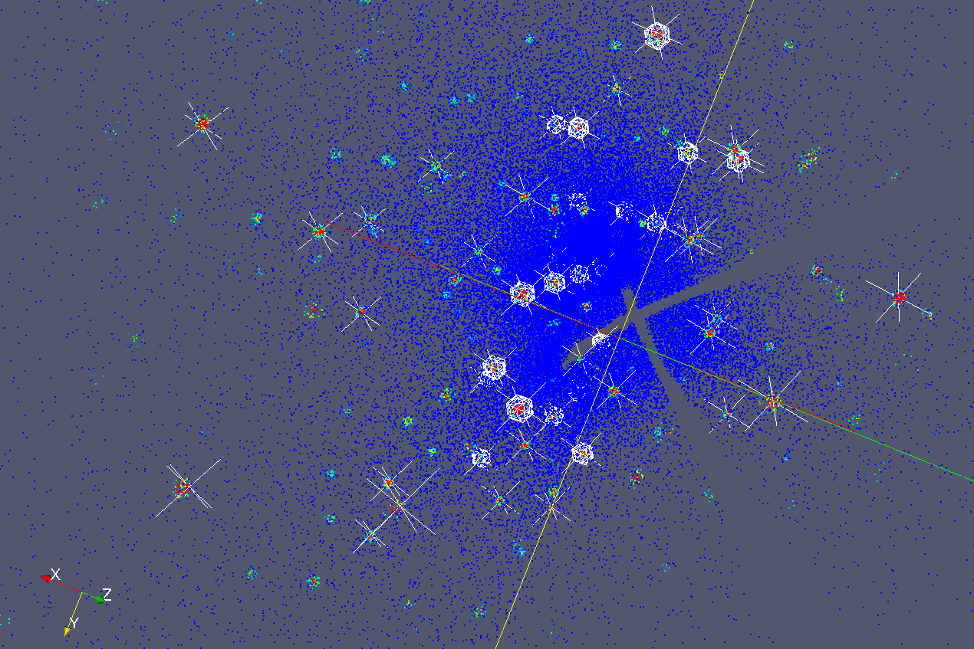
ParaView improvements for viewing Peaks

